Slide 1
Slowly Changing Dimension

Slide 2
Topics
Data Warehouse
SCD
SCD Types

Slide 3
What is Data Warehouse
In data warehousing, a common approach to dimensional modelling is through the concept of a star schema, a logical grouping of one or more fact tables surrounded by related dimension tables, linked via primary and foreign key relationships.

Slide 4
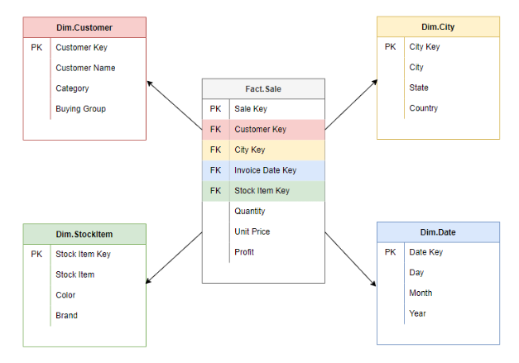
Fact tables contain measurements and foreign keys which refer to the primary keys in the associated dimension tables.
Dimension tables contain a collection of descriptive attributes that categorise facts to enable users to answer business questions.

Slide 5
What is SCD
A slowly changing dimension (SCD) is a dimension that is able to handle data attributes which change over time.
For example:
A customer dimension may hold attributes such as name, address, and phone number.
Over time, a customer's details may change (e.g. move addresses, change phone number, etc).

Slide 6
SCD Types
Type 0 - Retain original
Type 1 - Overwrite
Type 2 - Add a new record
Type 3 - Add a new field

Slide 7
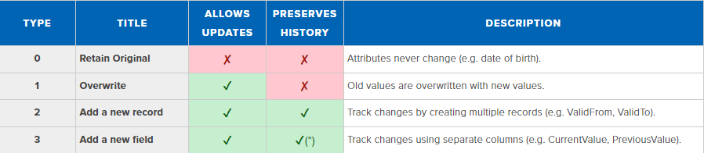
Summary of The Most Common SCD Types

Slide 8
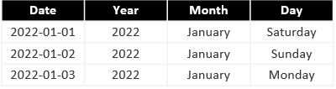
Type 0 - Retain original
In type 0, dimension attributes never change, the original value is always true. Type 0 applies to most date dimension attributes (e.g. for the date 2022-01-01, the day will always be Saturday, the month will always be January, etc).

Slide 9
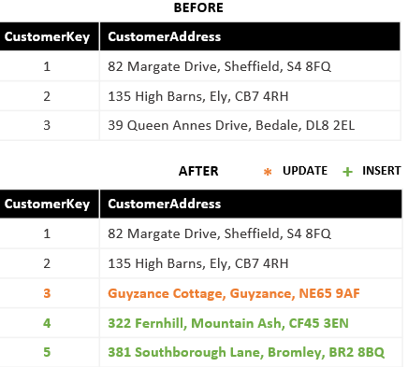
Type 1 - Overwrite
When new data arrives, the old attribute value in the dimension row are overwritten with the new value. While this technique is able to handle changes, this approach is unable to preserve history (i.e. simply reflects the most recent value).

Slide 10
Type 2 - Add a new record
When new data arrives, a new row is added to the dimension table with the updated attribute values. Since this can result in multiple rows describing different states of the same natural key, a surrogate key is needed to complement the natural key so that each row can be uniquely identified. Alongside the surrogate key are additional columns such as ValidFrom and ValidTo, to describe the period of time the record is relevant for, and finally a current row indicator such as isActive, to easily filter on the current state.

Slide 11
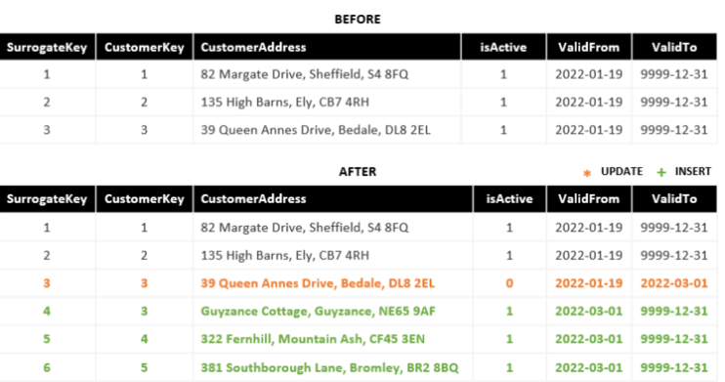
Summary of additional columns needed for type 2 include:
Surrogate Key (Unique identifier)
Effective Date (e.g. ValidFrom)
Expiration Date (e.g. ValidTo)
Current Row Indicator (e.g. isActive)

Slide 12
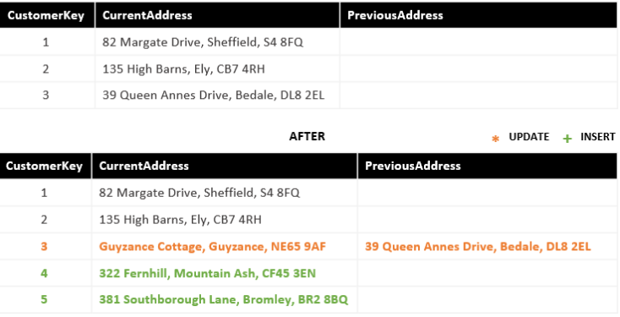
Type 3 - Add a new field
When new data arrives, a secondary column (e.g. PreviousValue) preserves the old value, the new value overwrites the primary column (e.g. CurrentValue).

